Slide 1
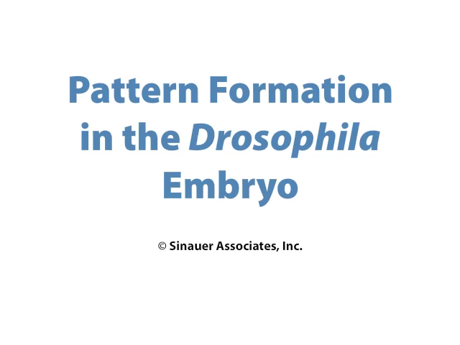
6.5 Drosophila Segment Identity

